Slide 1


HOW TO BUILD THE BUSINESS WITH
MASSIVE ACTION
PURNA & PURUSHOTTAMADASU DASARI

Slide 2

what IS VESTIGE BUSINESS ?
ZERO INVESTMENT
NO RISK
NO COMPETITION
NO TENSION
TIME FREEDOM
EXPERT TEAM’S SUPPORT & guidance

Slide 3

HOW TO build THE BUSINESS ?
HAVE A BIG DREAM.
ALWAYS BE POSITIVE.
ALWAYS SMILE ON YOUR FACE.
WEAR PROPER DRESS CODE.
FOLLOW THE WINNING TEAM SYSTEM & Your upline .
Develop your skills by following your upline.

Slide 4

DREAM BIG
AND
BELIVE YOURSELF

Slide 5
Understanding the Business Model

Slide 6


Slide 7


Have a great vision

Slide 8

Improve your Product knowledge

Slide 9

Building Your Network
Meet new people.
Create a physical meeting or online meeting for business explanation.
Make them as a your team.
Share your product knowledge to new people.
Regular contact with your team.

Slide 10

Building Your Network
Active more in social media Like (WhatsApp , insta , Facebook , YouTube)
Make more promotions.

Slide 11
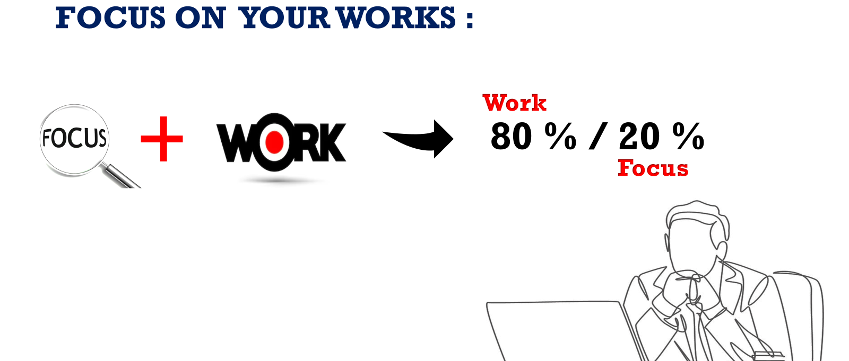

Slide 12

Importance of meetings
Meetings improv's your confident level.
We can meet success people in meetings.
We can gain good knowledge from success people.
It can improve business skills.

Slide 13

Importance of meetings
We can get great recognition on meetings.
It helps to develop leadership qualities.

Slide 14


Slide 15
How to Improve your Leadership
Leader must have “Vision”.
(The ability to set a clear direction and inspire others to work towards shared goals).
Leader must have “Continuous Learning”.
(A commitment to personal and professional development, staying open to new knowledge & skills.)
Leader must have “Accountability”.
(Taking responsibility for their actions and encouraging the same in their team members) .

Slide 16

How to Improve your Leadership
Leader must have “Inspiration”.
(Motivating and energizing the team to achieve their best through encouragement and support).
Leader must have “Adaptability”.
(Flexibility to adjust to changing circumstances and embrace new ideas and approaches.)

Slide 17

Build the business with strangers

Slide 18


Slide 19

Grow your business with support of winning team tools

Slide 20


Slide 21

Dream It & Just Do It

Slide 22


Thank you

